Slide 1
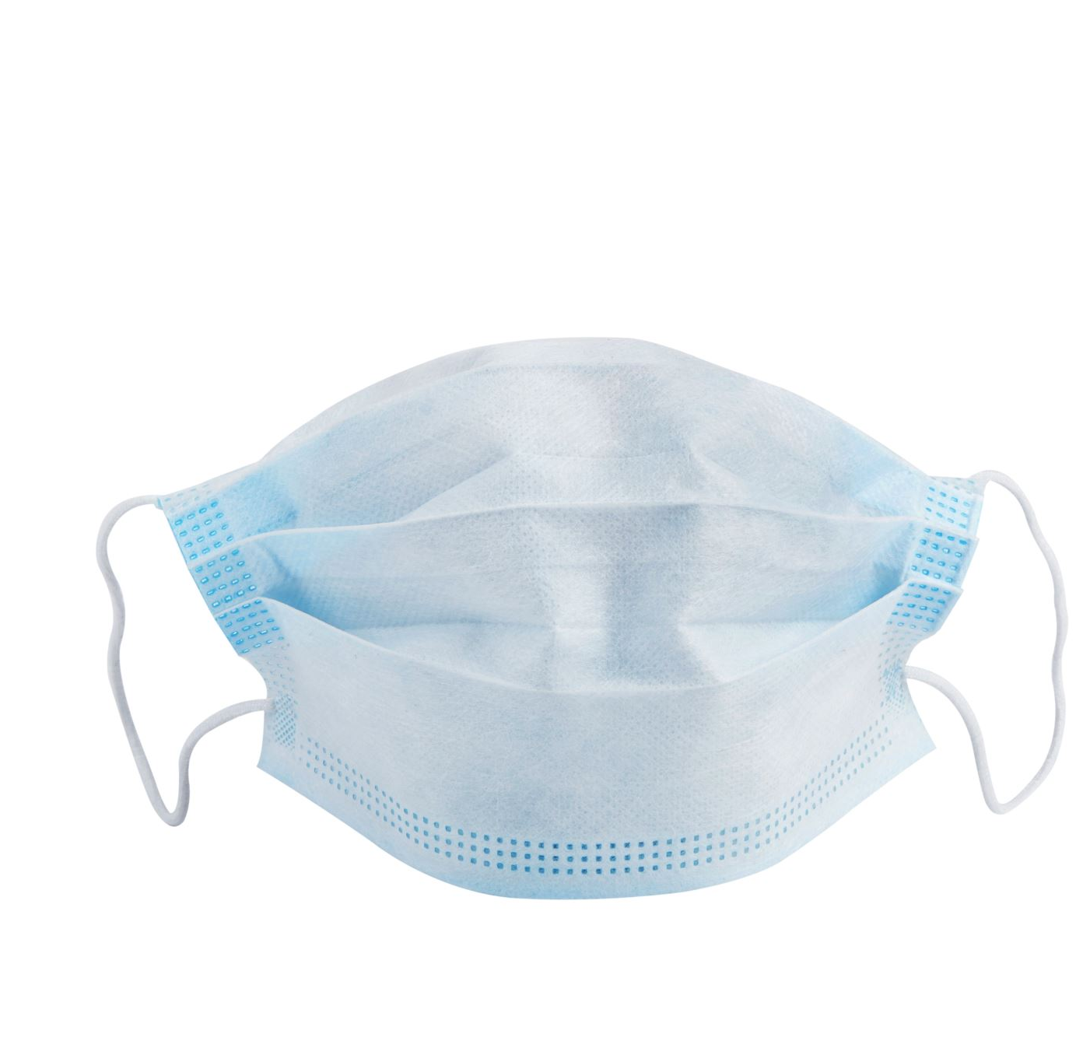
Face Mask detection using XG Boosting & MLP Vaagdevi Suryadevara(700741918) Jagadesh velagaa(7007416670) Vikram Dingari(700742014)

Slide 2
Roles and Responsibilities
Dataset collection: Vaagdevi Suryadevara
Processing coding: Jagadeesh Velaga
Algorithm implementation coding: Dingari Vikram

Slide 3
Problem summary
According to the World Health Organization (WHO), coronavirus disease 2019 (COVID-19) has infected over 79.2 million individuals and caused over 1.7 million fatalities until the end of 2020.
It is, however, more critical for individuals to protect themselves from the COVID-19 virus.
The studies demonstrated that surgical face masks can help limit coronavirus dissemination.
Automatic face mask detection has emerged as a critical computer vision task for assisting the worldwide community, but research on this is limited.
Face mask detection entails both the localization of faces and the recognition of mask wearing states, which we define the states as no mask wearing and mask wearing.
In this project we are going to detect the whether the person has mask on or not.

Slide 4

Dataset Summary
The dataset contains 12,941 training and 3,287 validation images containing wide variety of faces with no/partial/heavy occlusion on 62 diverse scenarios.
Categorized over two classes namely masked and non-masked was initially considered.
It is observed that MAFA is put up with an extrinsic class imbalanced problem that may introduce a bias towards the majority class.

Slide 5
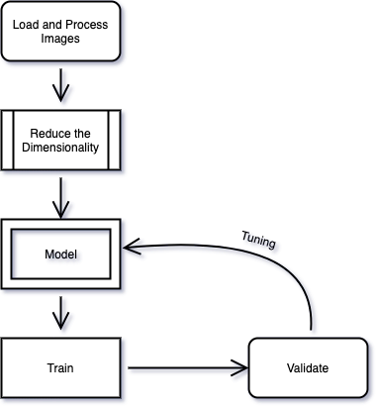
Process Summary

Slide 6
Process Summary
Load and Process Images
Images will be loaded into the python environment using CV2 library and converted into grayscale while loading the image. The images will be converted into 2D arrays so that it will be easy to process.
Reducing Dimensionality
The images are reshaped and resized into a given dimension. The dimension is 224 x 224 which means width and height of the images will be converted into 224 pixel using numpy library.
Model
Once the input and output are prepared, we can create and define classification models. It will be represented with an instance of the class DenseNet

Slide 7
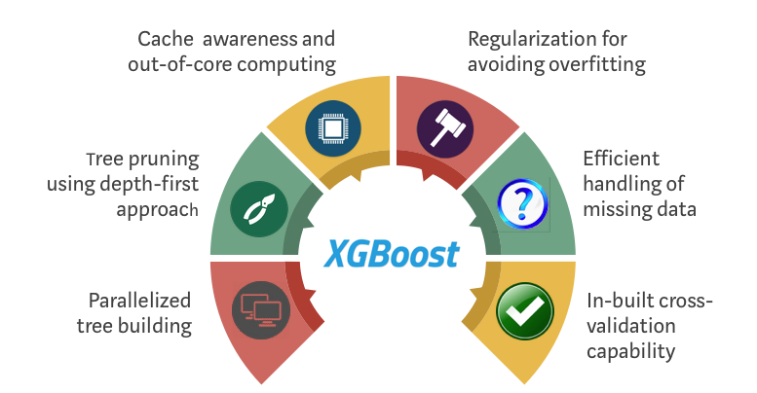
XG Boosting
XGBoost is a decision-tree-based ensemble Machine Learning method that makes use of a gradient boosting framework in order to enhance accuracy and speed.
XGBoost was developed by Microsoft Research and is named after the company's founder.
In prediction problems involving unstructured data (pictures, text, and so on), the performance of artificial neural networks tends to outperform that of every other algorithm or framework.
However, decision tree-based algorithms are regarded as the most effective method for handling small to medium-sized structured or tabular data sets.
Both XGBoost and Gradient Boosting Machines (GBMs) are examples of ensemble tree methods.
These ensemble tree methods both make use of the gradient descent architecture to apply the principle of boosting weak learners (in general, CARTs) in order to enhance their performance.

Slide 8
Multilayer perceptron
All MLPs have three distinct layers of nodes: input, hidden, and output.
Each node is a neuron that employs a nonlinear activation function, with the exception of the input nodes.
Backpropagation, a supervised learning method, is used in MLP training.
MLP differs from a linear perceptron in that it has multiple layers and non-linear activation.
Data that cannot be separated linearly can still be distinguished.
The MLP has multiple layers of nonlinearly activating nodes, including an input layer, an output layer, and possibly one or more hidden layers.
Due to the fully connected nature of MLPs, each node in one layer has a weighted connection to each node in the next layer.

Slide 9

Validation method
Classification Accuracy is what we usually mean, when we use the term accuracy. It is the ratio of number of correct predictions to the total number of input samples.
A Confusion matrix is an N x N matrix used for evaluating the performance of a classification model, where N is the number of target classes.
The matrix compares the actual target values with those predicted by the machine learning model.
This gives us a holistic view of how well our classification model is performing

Slide 10
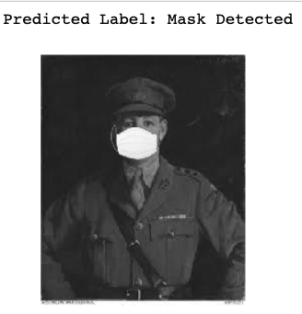
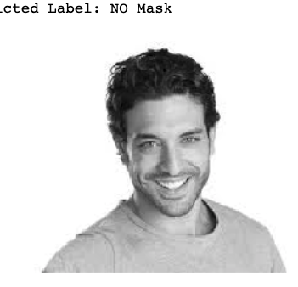
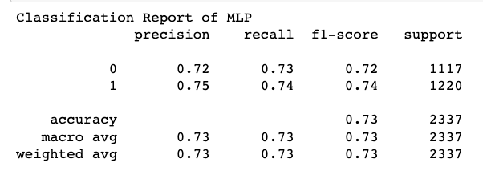
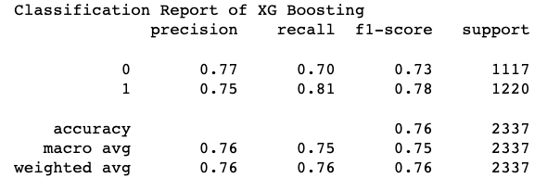
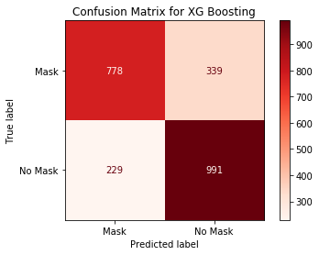
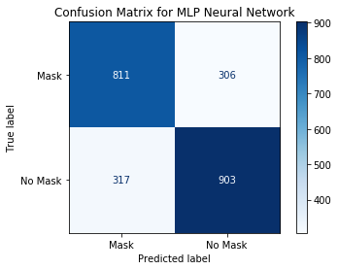
Result - summary
XG Boosting model Accuracy
XG Boosting Model Result
MLP model result
MLP model Accuracy

Slide 11
Conclusion
In this project, we offer a machine learning-based system for recognizing masks over faces in public settings, with the goal of reducing the spread of Coronavirus among the general public.
Because of the employment of an ensemble of single and two-stage detectors at the pre-processing level, the suggested technique efficiently handles occlusions in dense settings.
A further benefit of combining the use of machine learning models with extensive testing over an unbiased dataset is the creation of a system that is both extremely robust and low-cost.
The XG Boosting technique outperforms the competition.
Recognizing the facial mask in the deep woodland is difficult.
It is capable of detecting a facial mask that has equal weighting and performance.

